Slide 1

Financial AID FOR COLLEGE
Presented by Kaleo Domingo

Slide 2





Cost of Attendance Varies
Tuition
+ BOOKS
$1000
School 1
2 year - Public
$3,024
School 2
4 year -Public
$10,872
School 3
Private
$33,441
?

Slide 3

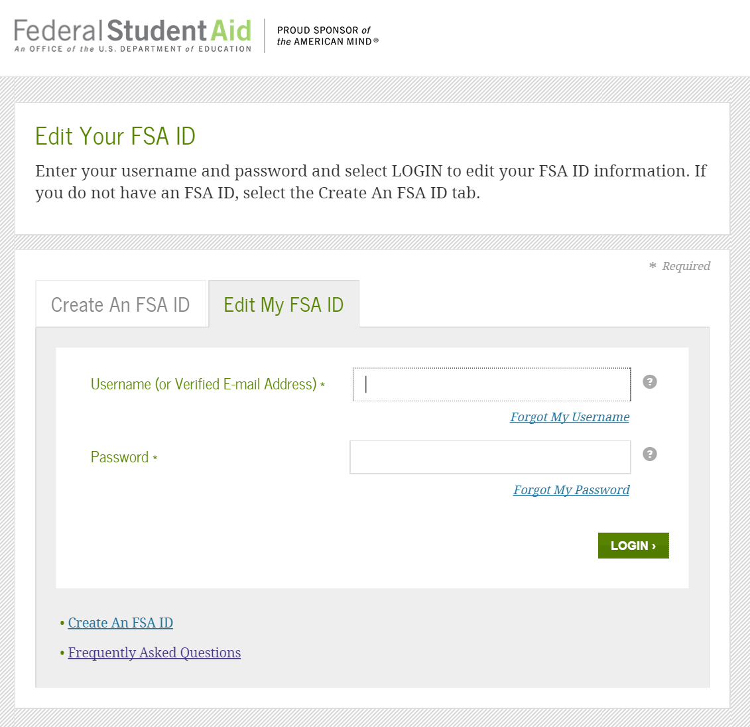
FAFSA (Free Application for Federal Student Aid)
FAFSA.GOV
FSAID.ED.GOV
Application
October 1st
FSA ID Login
Student and Parent

Slide 4

FAFSA Application Tips
File each year as early as OCT 1st
Have FSA ID ready for student and parent
Have copy of federal tax return and W-2s
Income and assets (exclude retirement accounts and home)
List the college(s) of interest
Student housing plans (on-campus, off-campus, parent)
Inform financial aid of special circumstances.

Slide 5

What happens after I file a FAFSA?
Review your FAFSA comments and results.
Information sent to colleges
Check your school email
Complete any additional documentation
Receive financial aid award notification
Check on status if unsure

Slide 6



Scholarship Applications
FAFSA + Scholarship Applications
Maintain/update a personal statement
Have at least two letters of recommendation
Keep record of service activities
Better grades = better scholarship application
School’s website
uhsys.scholarships.ngwebsolutions.com
HawaiiCommunityFoundation.org
apps.ksbe.edu/financialaid/
www.fastweb.com
www.finaid.org

Slide 7
Sample Financial Aid Awards - FAFSA
School 1
2 year - Public
School 2
4 year - Public
$6095
$6095
Pell Grant
SEOG Grant
UH Opportunity Grant
Native Hawaiian Grant
Scholarships
Student Loans
Parent Loan
Work Study
$500
$2000
$1000
$4000
$500
$2000
$8,095
$14,095
???
???
$5,500 - $10,500
COA - EFC - Fin Aid = Max Loan Amount/yr

Slide 8

Satisfactory Academic Progress
Maintain Financial Aid Academic Requirements
  Credit Completion Rate of 67% or Higher (Check the schools SAP policy)
  Minimum cumulative GPA of 2.0 (Most common Standard)
  Max Timeframe
Enroll in courses that count towards degree
Meet with your counselor to ensure your on track to graduate

Slide 9

Strategies for Success!
FAFSA OCT 1st
Track financial aid and scholarship deadlines
Follow up on your application - it is your responsibility
Higher education is an investment in your future
Don’t be afraid to ask questions. It’s part of learning
Questions ???
MAHALO and best wishes!

